Slide 1
How to work with strings

Slide 2
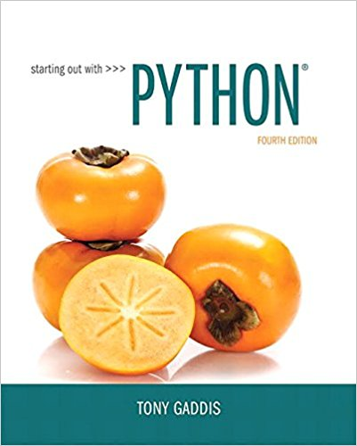
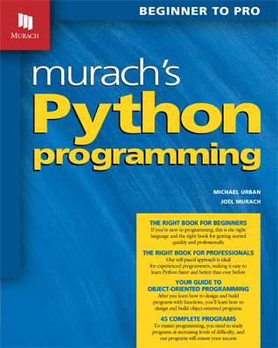
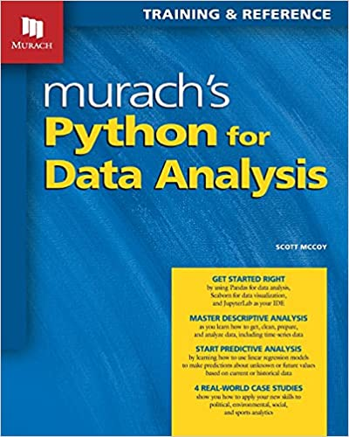
Slides are taken and adapted from:

Slide 3
Topics
Basic String Operations
String Slicing
Testing, Searching, and Manipulating Strings

Slide 4
Basic String Operations
Many types of programs perform operations on strings
In Python, many tools for examining and manipulating strings
  Strings are sequences, so many of the tools that work with sequences work with strings

Slide 5
Accessing the Individual Characters in a String
To access an individual character in a string:
  Use a for loop
    Format: for character in string:
    Useful when need to iterate over the whole string, such as to count the occurrences of a specific character
  Use indexing
    Each character has an index specifying its position in the string, starting at 0
    Format: character = my_string[i]

Slide 6
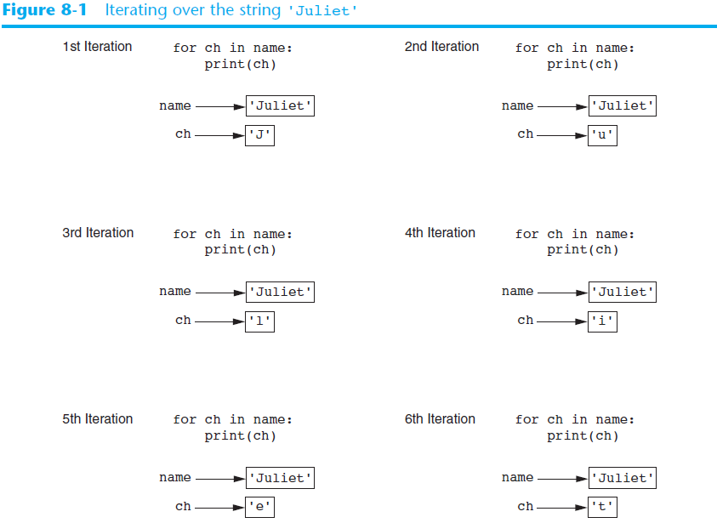

Slide 7
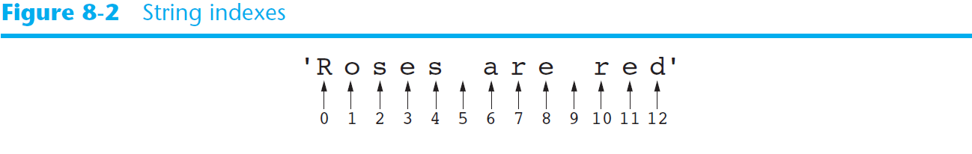
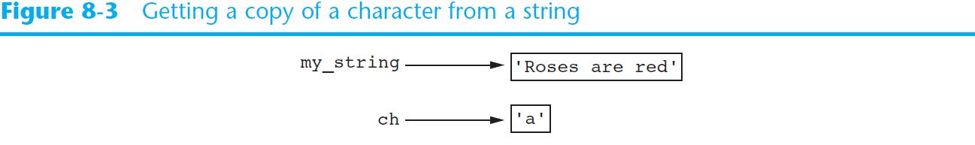
Accessing the Individual Characters in a String (cont’d.)

Slide 8
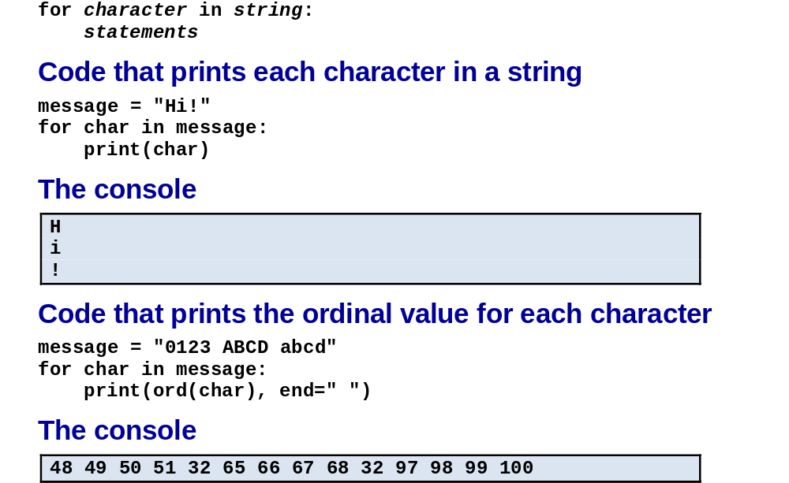
The syntax for looping over each character in a string
C10, Slide <number>

Slide 9

Accessing the Individual Characters in a String (cont’d.)
IndexError exception will occur if:
  You try to use an index that is out of range for the string
    Likely to happen when loop iterates beyond the end of the string
len(string) function can be used to obtain the length of a string
  Useful to prevent loops from iterating beyond the end of a string

Slide 10
String Concatenation
Concatenation: appending one string to the end of another string
  Use the + operator to produce a string that is a combination of its operands
  The augmented assignment operator += can also be used to concatenate strings
    The operand on the left side of the += operator must be an existing variable; otherwise, an exception is raised

Slide 11
Strings Are Immutable
Strings are immutable
  Once they are created, they cannot be changed
    Concatenation doesn’t actually change the existing string, but rather creates a new string and assigns the new string to the previously used variable
  Cannot use an expression of the form
  string[index] = new_character
    Statement of this type will raise an exception

Slide 12
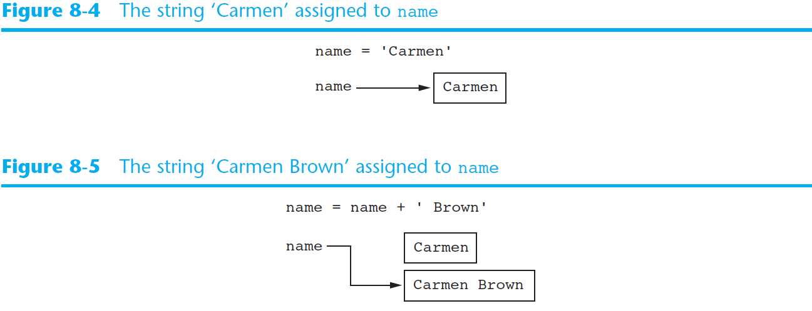
Strings Are Immutable (cont’d.)

Slide 13
String Slicing
Slice: span of items taken from a sequence, known as substring
  Slicing format: string[start : end]
    Expression will return a string containing a copy of the characters from start up to, but not including, end
    If start not specified, 0 is used for start index
    If end not specified, len(string) is used for end index
  Slicing expressions can include a step value and negative indexes relative to end of string

Slide 14
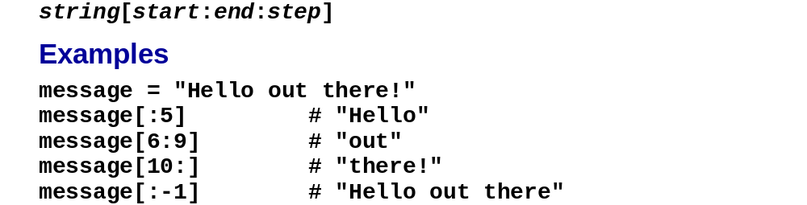
How to slice a string
C10, Slide <number>

Slide 15
Testing, Searching, and Manipulating Strings
You can use the in operator to determine whether one string is contained in another string
  General format: string1 in string2
    string1 and string2 can be string literals or variables referencing strings
Similarly you can use the not in operator to determine whether one string is not contained in another string

Slide 16
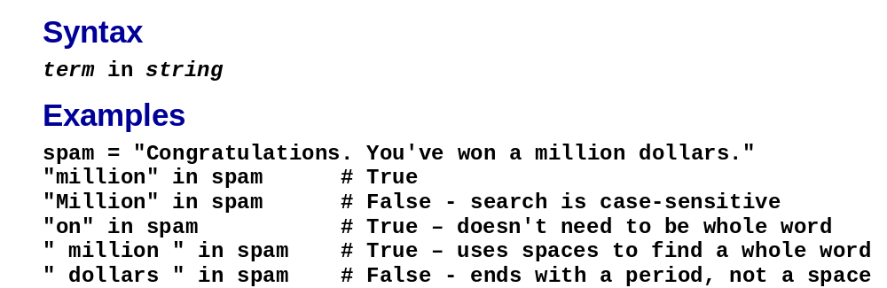
How to use the in keyword to search a string
C10, Slide <number>

Slide 17
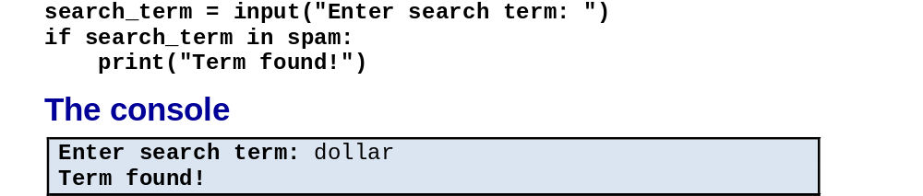
Code that uses an if statement to check a search
C10, Slide <number>

Slide 18
String Methods
Strings in Python have many types of methods, divided into different types of operations
  General format: mystring.method(arguments)
Some methods test a string for specific characteristics
  Generally Boolean methods, that return True if a condition exists, and False otherwise

Slide 19
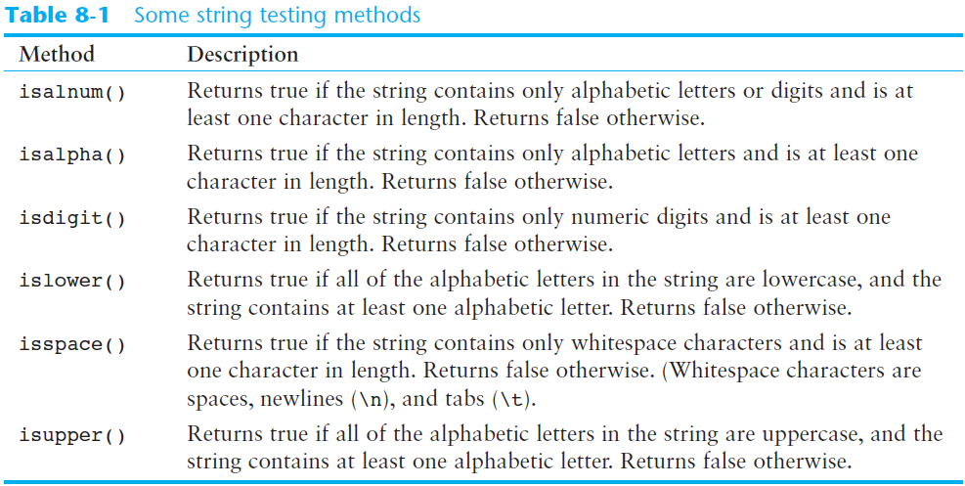
String Methods (cont’d.)

Slide 20
String Methods (cont’d.)
Some methods return a copy of the string, to which modifications have been made
  Simulate strings as mutable objects
String comparisons are case-sensitive
  Uppercase characters are distinguished from lowercase characters
  lower and upper methods can be used for making case-insensitive string comparisons

Slide 21
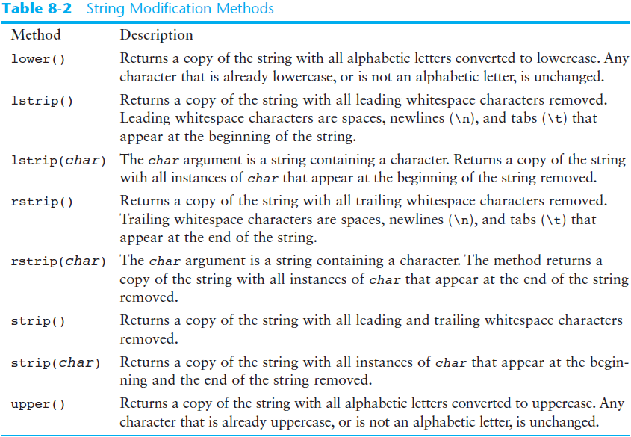
String Methods (cont’d.)

Slide 22
String Methods (cont’d.)
Programs commonly need to search for substrings
Several methods to accomplish this:
  endswith(substring): checks if the string ends with substring
    Returns True or False
  startswith(substring): checks if the string starts with substring
    Returns True or False

Slide 23
String Methods (cont’d.)
Several methods to accomplish this (cont’d):
  find(substring): searches for substring within the string
    Returns lowest index of the substring, or if the substring is not contained in the string, returns -1
  replace(substring, new_string):
    Returns a copy of the string where every occurrence of substring is replaced with new_string

Slide 24
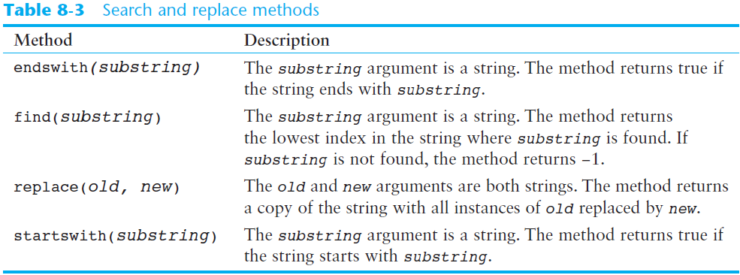
String Methods (cont’d.)

Slide 25
The Repetition Operator
Repetition operator: makes multiple copies of a string and joins them together
  The * symbol is a repetition operator when applied to a string and an integer
    String is left operand; number is right
  General format: string_to_copy * n
  Variable references a new string which contains multiple copies of the original string

Slide 26
How to use the repetition operator (*)
C10, Slide <number>

Slide 27
Splitting a String
split method: returns a list containing the words in the string
  By default, uses space as separator
  Can specify a different separator by passing it as an argument to the split method

Slide 28
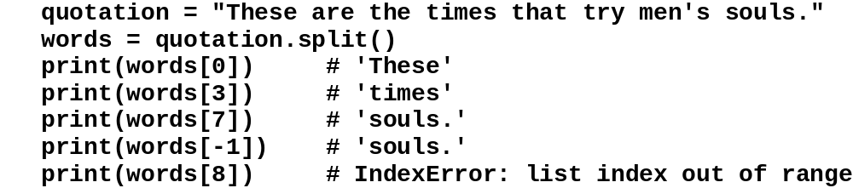
How to split a string on whitespace
C10, Slide <number>

Slide 29
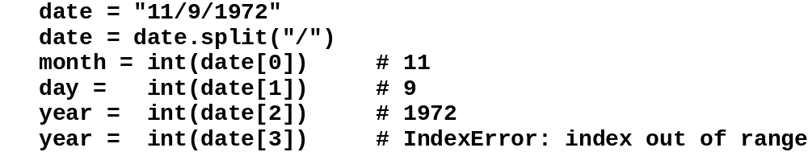
How to split a date on a delimiter
C10, Slide <number>

Slide 30
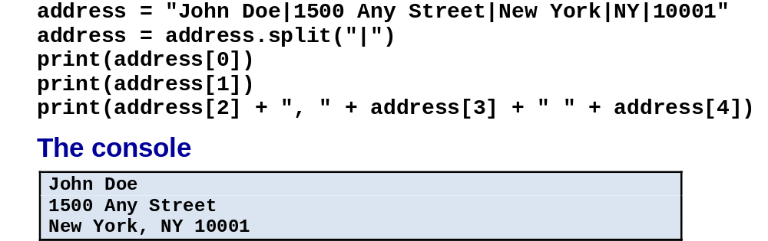
How to split a row of data on a delimiter
C10, Slide <number>

Slide 31
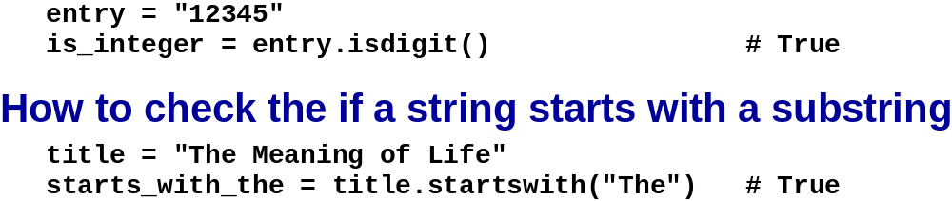
How to check if a string contains all digits
C10, Slide <number>

Slide 32
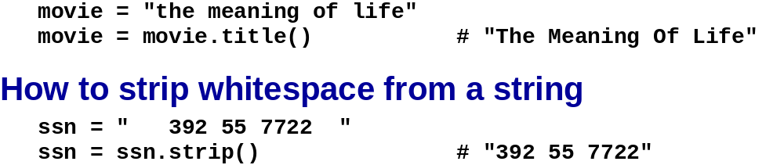
How to change a string to title case
C10, Slide <number>

Slide 33
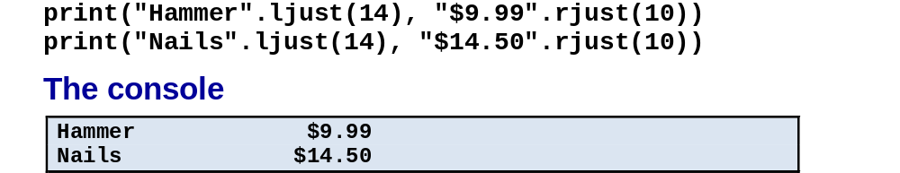
How to align strings by using justification
C10, Slide <number>

Slide 34
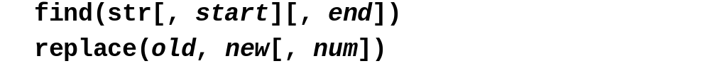
The find() and replace() methods of a string
C10, Slide <number>

Slide 35
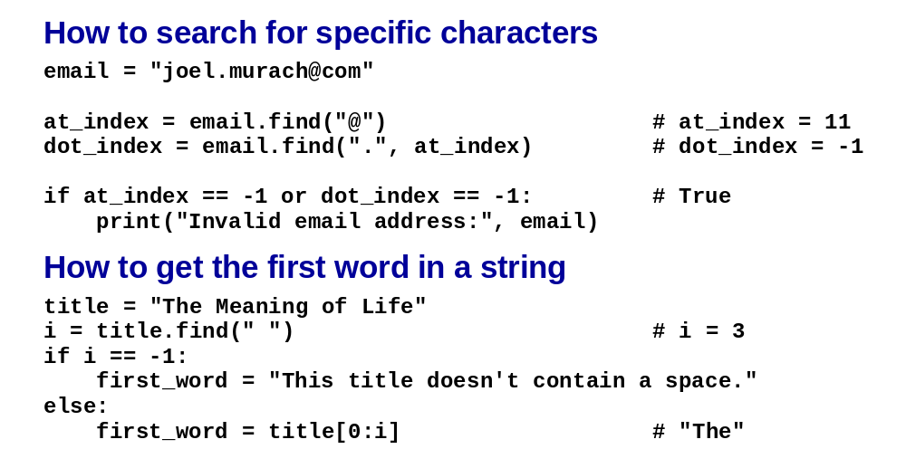
Find examples
C10, Slide <number>

Slide 36
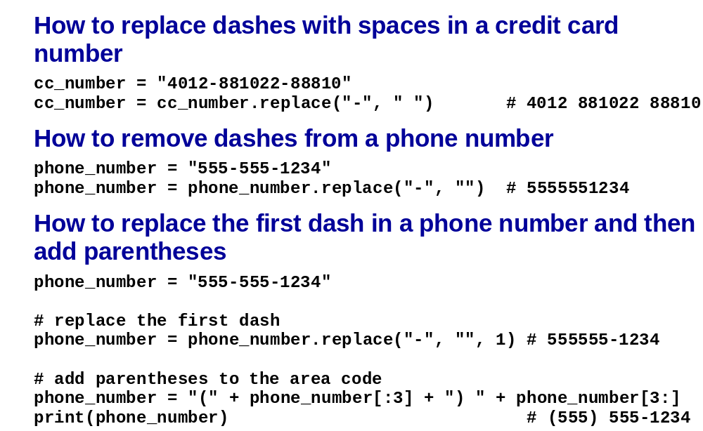
Replace examples
C10, Slide <number>

Slide 37
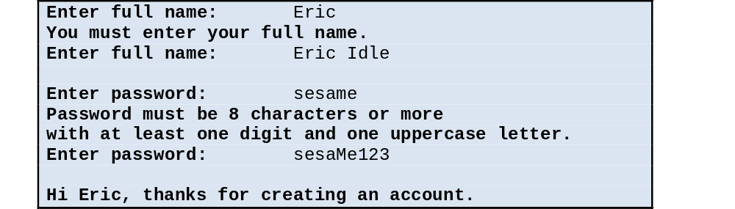
The user interface for the Create Account program
C10, Slide <number>

Slide 38
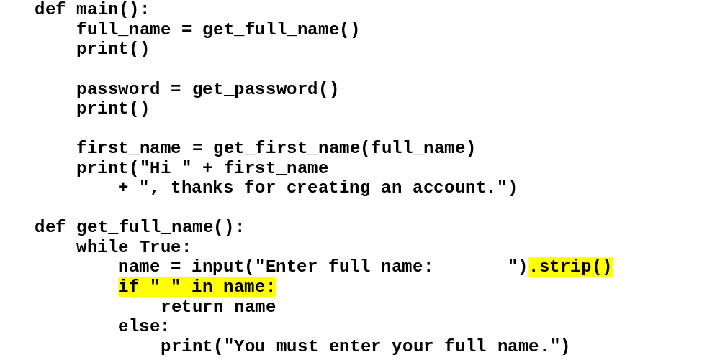
The code
C10, Slide <number>

Slide 39
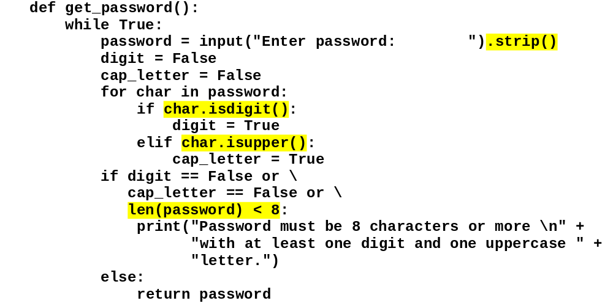
The code (cont.)
C10, Slide <number>

Slide 40
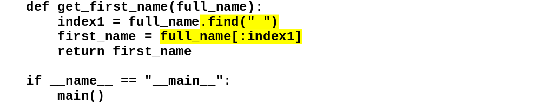
The code (cont.)
C10, Slide <number>

Slide 41
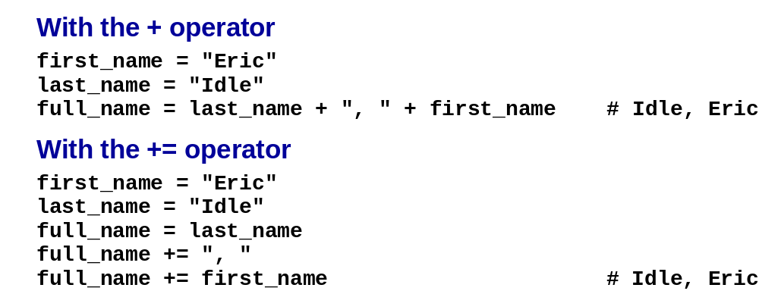
How to join strings with the + and += operators
C10, Slide <number>

Slide 42
The join() method of a string
C10, Slide <number>

Slide 43
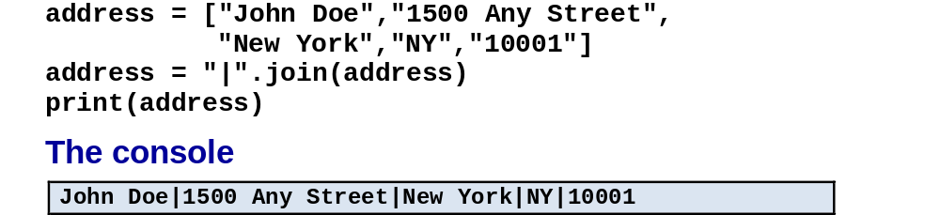
How to join the items of a list
C10, Slide <number>

Slide 44
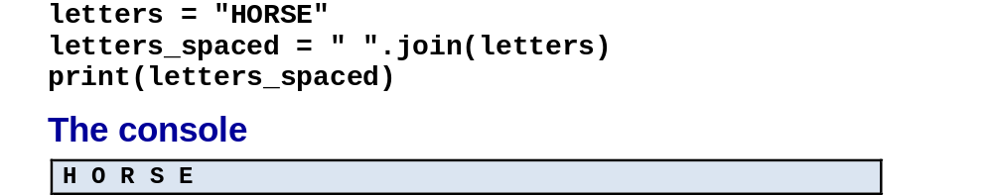
How to join the characters in a string
C10, Slide <number>

Slide 45
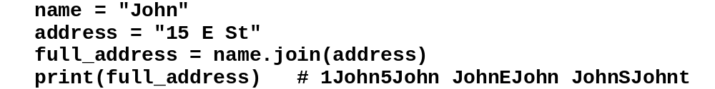
A common error when using the join() method
C10, Slide <number>

Slide 46
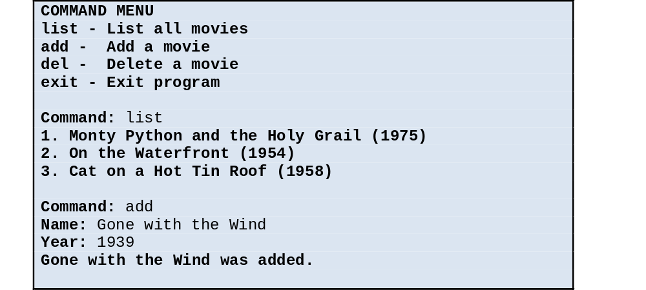
The console
C10, Slide <number>

Slide 47
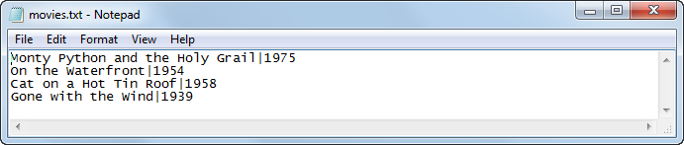
The data in the text file after one record has been added to it
C10, Slide <number>

Slide 48
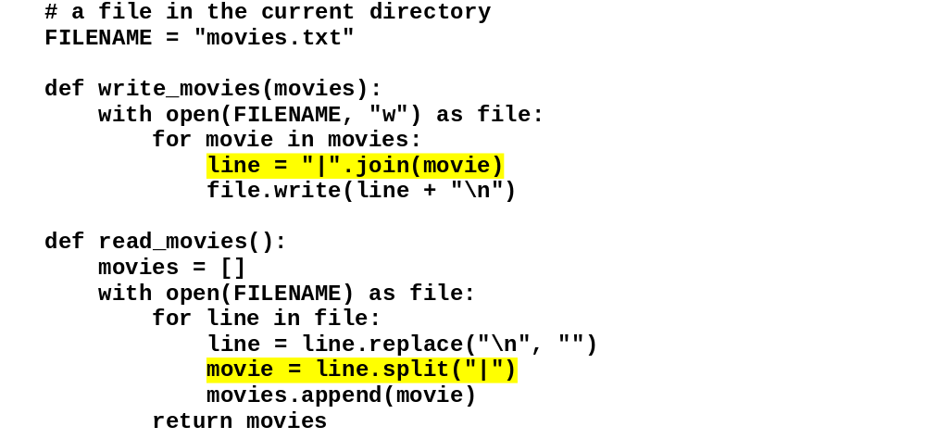
The code
C10, Slide <number>

Slide 49
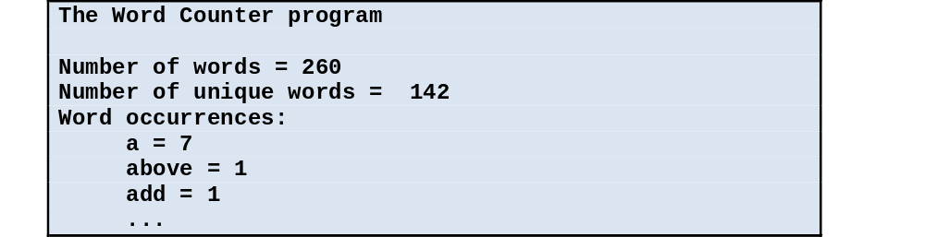
The user interface for the Word Counter program
C10, Slide <number>

Slide 50
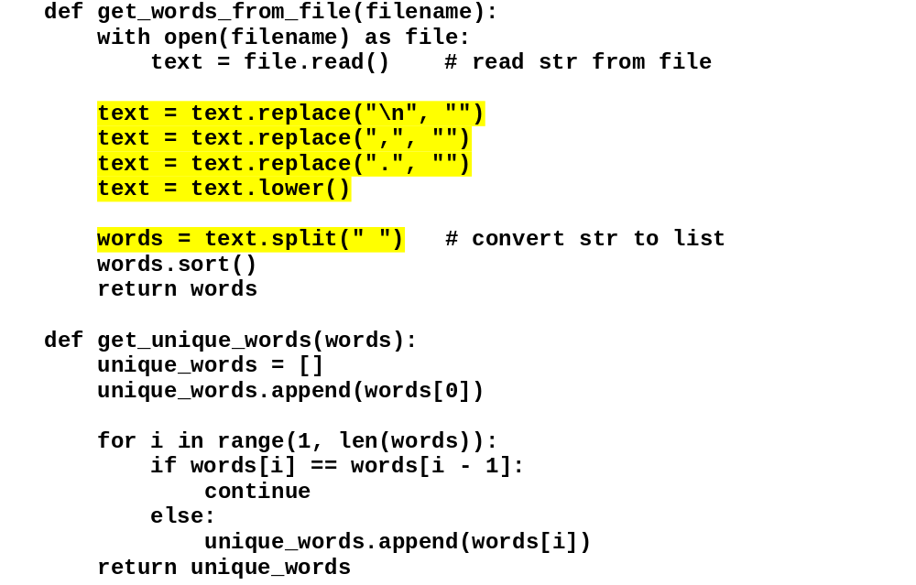
The code
C10, Slide <number>

Slide 51
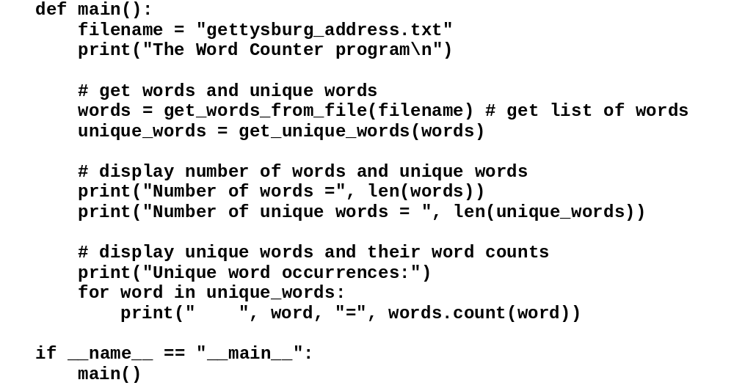
The code (cont.)
C10, Slide <number>

Slide 52
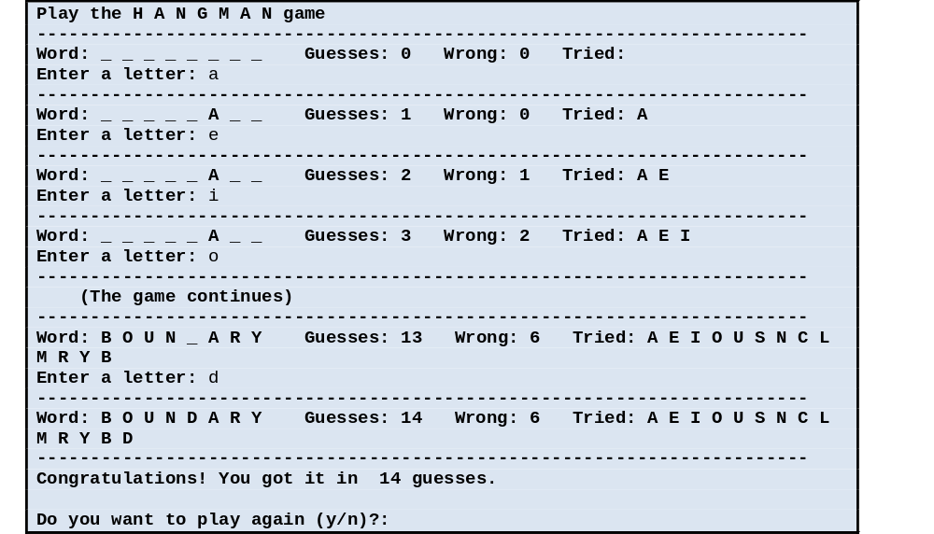
The user interface for the Hangman game
C10, Slide <number>

Slide 53
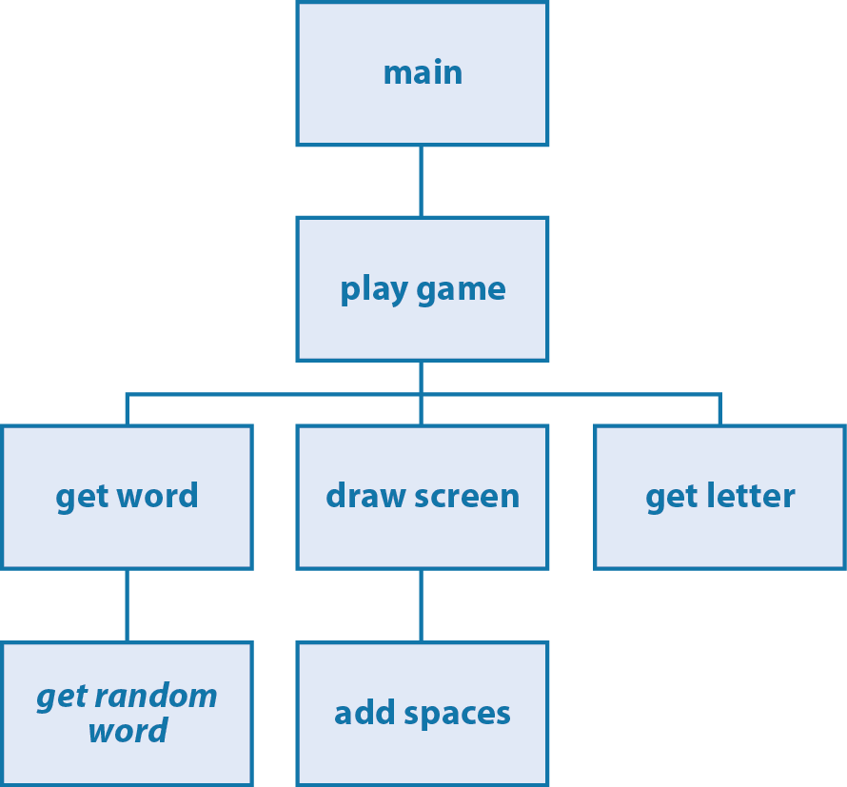
The hierarchy chart for the Hangman game
C10, Slide <number>

Slide 54
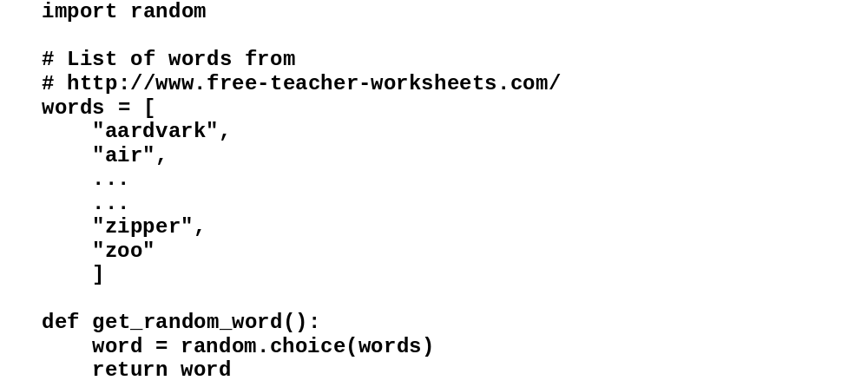
The wordlist module
C10, Slide <number>

Slide 55
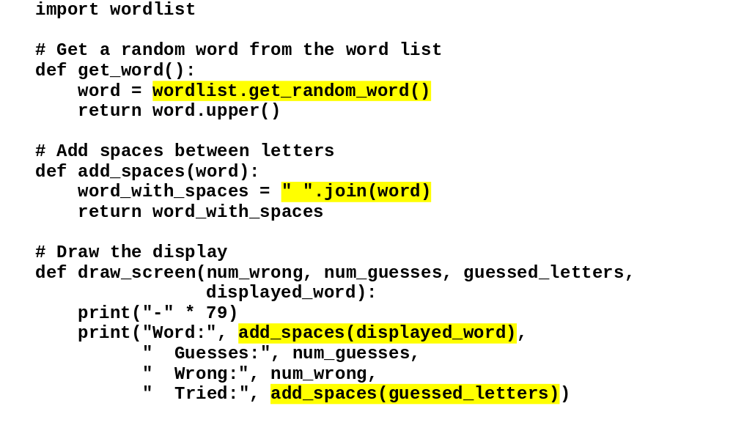
The hangman module
C10, Slide <number>

Slide 56
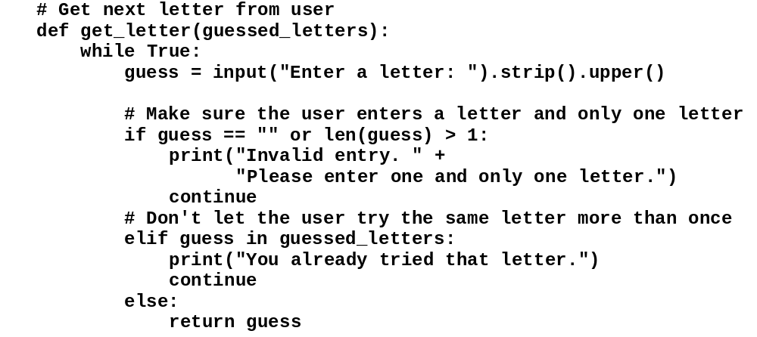
The hangman module (cont.)
C10, Slide <number>

Slide 57
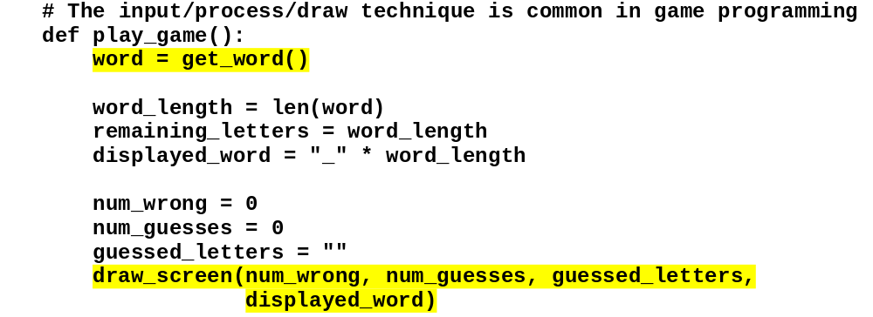
The hangman module (cont.)
C10, Slide <number>

Slide 58
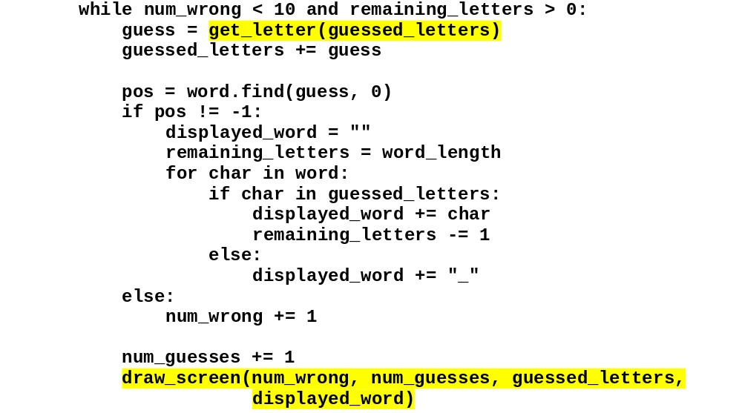
The hangman module (cont.)
C10, Slide <number>

Slide 59
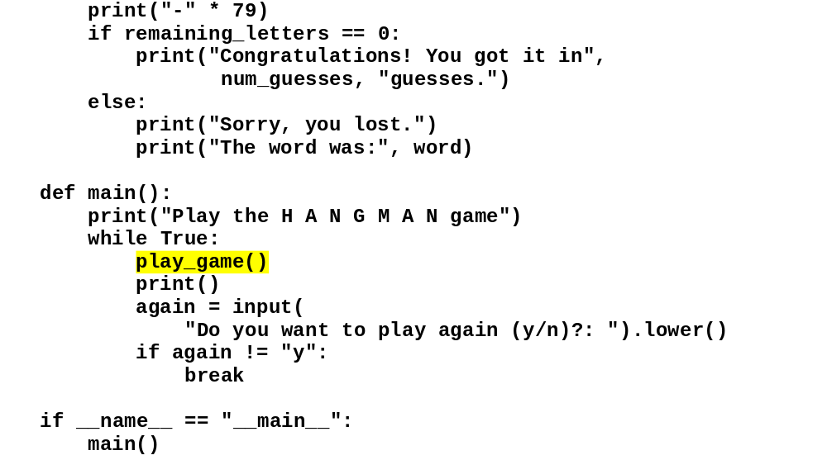
The hangman module (cont.)
C10, Slide <number>

